Slide 1
.
A supported Program.

Slide 2
A Training on
The Art of Negotiation:
Less formal and more effective
Method Of ADR.

Slide 3
.
The Trainer:
Barrister Khandoker M. S. Kawsar
Email: kawsar215@yahoo.co.uk
Mobile: 0088-01911 12 12 88

Slide 4
A Training on
No formality of Appointing formal Arbitrator or Mediator, or no other formalities.
Thousands of disputes are resolved daily by negotiation.
The Art of Negotiation:
Less formal and more effective
Method Of ADR.
Less formal
more effective
Method Of ADR.
Negotiation
Mediation
Arbitration

Slide 5

Training Outline:
The Training is outlined as a treatment to a disease (if any).
First step is- the disease is diagnosed,
Second step is- medicine is given accordingly,
Third step is- observing the development of the disease treated,
Final step is- Giving final feedback about the development.

Slide 6
Training Outline:
Part-1: We will assess the inherent skills of the participants (by Thomas-Kilmann method).
Part-2: General lecture on Negotiation, Stages of a negotiation, Negotiation skill development (creative ability, effective communication, bargaining style, maintaining relationship etc) and a discussion on Integrative Negotiation method.
Part-3: Personal Feedback as well as personal Advice on the skills of the participants.
Part-4: Group Exercise in couple.
Part-5: Feedback on ‘Development towards being a good negotiator’.

Slide 7
Part-1:
The Exercise: Questionnaire on Participant’s current skills in conflict resolution (Thomas-Kilmann method):
Every participant will be given with a Questionnaire and with an answer sheet. The participants will fill up the answer sheet and count the marks themselves against each column. We will give each participant the feedback about their behavior and inclination. We will give advices how to improve their behavior in line of the behavior of a good negotiator.

Slide 8
Part-2
GENERAL LECTURE ON NEGOTIATION

Slide 9
Introduction to Negotiation
Introduction to Negotiation
ORIGIN OF THE TERM | The word "negotiation" originated in the early 15th century from the Old French and Latin expressions “negociacion” and “negotiationem.” These terms mean “business, trade and traffic.” By the late 1590s negotiation had the definition, "to communicate in search of mutual agreement." With this new introduction and this meaning, it showed a shift in “doing business” to “bargaining about” business.
DEFINITION | Negotiation is to try to reach an agreement or compromise by discussion. Negotiation is perhaps the freest form of consensual self-help and party autonomy in the settlement of disputes and, it is suggested, should always be the first step in the resolution of any dispute. Negotiation is a process two or more humans undertake when they realise that communication is necessary to arrive at an accommodation on some point of mutual interest.
The word "negotiation" originated in the early 15th century from the Old French and Latin expressions “negociacion” and “negotiationem.” These terms mean “business, trade and traffic.” By the late 1590s negotiation had the definition, "to communicate in search of mutual agreement." With this new introduction and this meaning, it showed a shift in “doing business” to “bargaining about” business.
Negotiation is to try to reach an agreement or compromise by discussion. Negotiation is perhaps the freest form of consensual self-help and party autonomy in the settlement of disputes and, it is suggested, should always be the first step in the resolution of any dispute. Negotiation is a process two or more humans undertake when they realise that communication is necessary to arrive at an accommodation on some point of mutual interest.

Slide 10

Not the spirit of Negotiation-
We cannot negotiate with those who say, "What's
mine is mine and what's yours is negotiable."
-John F. Kennedy, former President of the United States

Slide 11

Negotiation:
Sword and Shield
Or
Sword or Shield
You can get much farther with a kind word and a gun
than you can with a kind word alone.
-Al Capone, an Italian-American gangster

Slide 12
The Negotiation Process:
The negotiating process involves balancing matters between two parties so that the negotiator not only get what he wants but also get what he wants in the best possible way (Forsyth, 2009). Companies should pay more attention on how to get at the destination but also at the same time should not lose the sight of the destination. It is all about the process.
By getting as well as maintaining the relationship
সাপ মারল এবং লাঠি ও ভাঙল না…

Slide 13
.
Negotiation
Litigation
Mediation
Arbitration
‘Negotiation’ is the first step in the resolving any dispute through any other methods.

Slide 14

.

Slide 15
Scopes of Negotiation for Corporate Officials

Slide 16
Scopes of Negotiation for Corporate Officials:
Some options/scopes might be very much unrealistic for some, but realistic for others.
Possible scopes might be as follows:

Slide 17
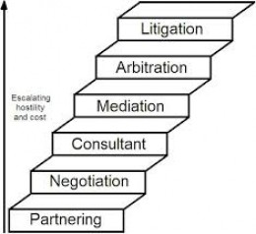
Scopes of Negotiation for Corporate Officials:
Scope-1: Any Corporate or Commercial Dispute:
Negotiation should be the earlier step to resolve any Corporate or Commercial Dispute before going to Mediation, Arbitration or Litigation.

Slide 18

Scopes of Negotiation for Corporate Officials:
Scope-2: Salary:
You can claim better salary if you think you deserve.

Slide 19

Scopes of Negotiation for Corporate Officials:
Scope-3: Additional Vacation Time:
Getting a few extra vacation days to lie on a white sandy beach staring at crystal blue water might be worth more to you than a higher salary.

Slide 20

Scopes of Negotiation for Corporate Officials:
Scope- 4: Flexible Scheduling:
Flexible scheduling in some works, such as teaching, will boost up your energy to work better.

Slide 21
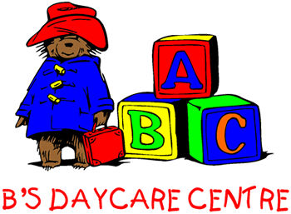
Scopes of Negotiation for Corporate Officials:
Scope-5: Daycare Reimbursement:
Ask what child care options the company offers. If nothing of that nature exists, inquire about getting a partial amount of your child care costs paid for by your company.

Slide 22

Scopes of Negotiation for Corporate Officials:
Scope-6: Tuition Reimbursement:
Tuition assistance from workshops to seminars, conferences to even paying for your degree, because ultimately this investment is going to the business.

Slide 23

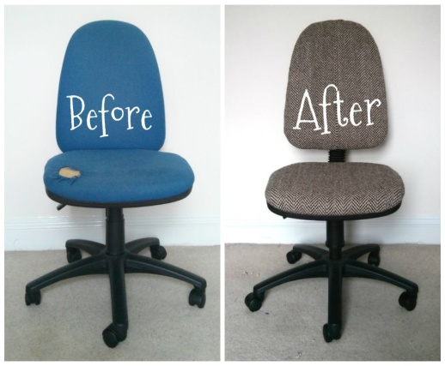
Scopes of Negotiation for Corporate Officials:
Scope- 7: An Office:
Depending on your job level, you can ask for a better office.

Slide 24
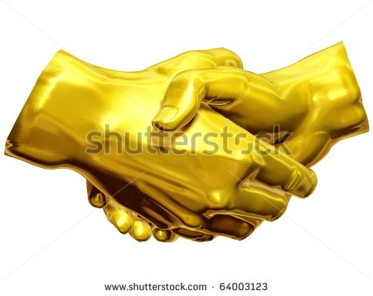
Scopes of Negotiation for Corporate Officials:
Scope-8: Guaranteed Golden handshake Package:
Ask the manager if you can get a guaranteed severance package written into your contract should the company become bankrupt or lays you off due to no fault of your own.

Slide 25

Scopes of Negotiation for Corporate Officials:
Scope- 9: Housing Subsidy:
Different from asking for your company to cover your transportation costs, this perk comes in the form of a company apartment that you might be able to crash in if you’ll be pulling late nights at the office.

Slide 26
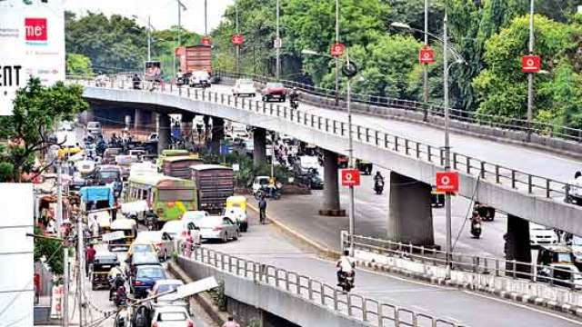
Scopes of Negotiation for Corporate Officials:
Scope-10: Transportation Reimbursement:
Calculate the travel expenses you plan to incur each month, and ask for a stipend to help ease this expense. Your company might add this onto your contract if it means you’ll be in the office each day and on time.

Slide 27

Scopes of Negotiation for Corporate Officials:
Scope-11 : A Wardrobe Allowance:
You can petition for a clothing stipend to be built into your contract - especially if you’re in the position of meeting with lots of high-end power clients. After all, the company will want you to look your best since you are representing them.

Slide 28

Scopes of Negotiation for Corporate Officials:
Scope-12: A Better Title:
For example, The title “Secretary” just doesn’t sound amazing, but “Corporate Executive Assistant” sounds a little better. So ask if you can have a title change that accurately reflects what your workload will be, which also will help you when you start looking for another job in the future.

Slide 29

Scopes of Negotiation for Corporate Officials:
Scope-13: Day-to-Day small disputes:
Managers as well as any employee can be the negotiators. Small disputes may be between employees as well as between the employees and the clients.

Slide 30
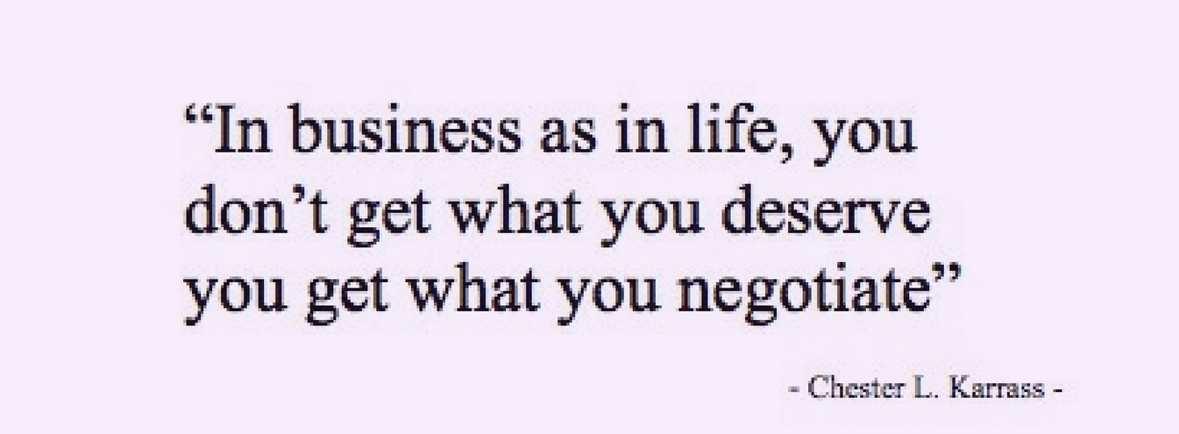
Impact of Negotiation in everyday life:

Slide 31

Advantages of Negotiation

Slide 32

Advantages of Negotiation in compared to Arbitration and Mediation
Cost: The most powerful advantage of negotiation is cost. While nothing in dispute resolution is completely cost free, Negotiation as a central part of human negotiation is at least familiar and fits in with the general processes of life.

Slide 33
Advantages of Negotiation in compared to Arbitration and Mediation
Time: Negotiation is also almost certainly the quickest form of dispute resolution. Dispute is not part of the productive operations of any commercial organization. The speed inherent in productive negotiations comes from the familiarity with the subject and personnel involved in the dispute and the general access to the subject and each other. Speed has two benefits: the ability to recognise and react quickly to disagreements or disputes and resolve them before they grow and the clear benefit of being able to reach a resolution enables you to concentrate on the purpose at hand. Time spent disputing is non-productive and wasteful.

Slide 34
Advantages of Negotiation in compared to Arbitration and Mediation
Familiarity with the process, the individuals,Organizations and the subject:
The parties are face to face (figuratively if not always literally), a position that they inhabit throughout their normal dealings. This can carry great advantages in: familiarity with each other aiding communication, familiarity with the subject of the dispute and the minutiae of its gestation (which will, if nothing else, inform the discussions). Familiarity with the process, the individuals, organisations and the subject will increase the options for a settlement – providing that the parties wish to settle.

Slide 35
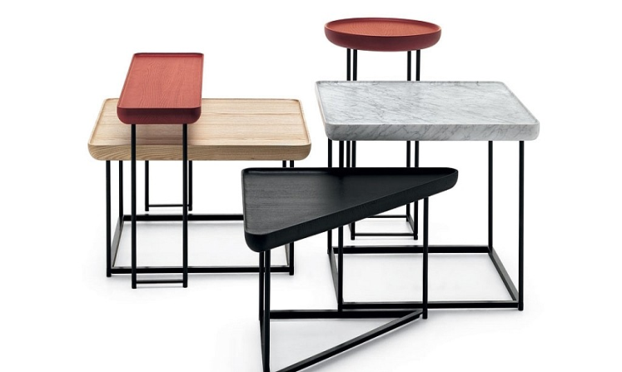
Advantages of Negotiation in compared to Arbitration and Mediation
Flexibility: Flexibility is inherent in negotiations; the parties, while they may have to make efforts to meet and discuss, are not at the mercy of a third party organization or individual for the timing of their discussions. Indeed, it is not necessarily a requirement of negotiations that they meet at all. Negotiations are flexible enough to be carried out by telephone, conference call, internet or correspondence.

Slide 36
Advantages of Negotiation in compared to Arbitration and Mediation
Private: The negotiations are inherently private, unless the parties choose otherwise; there is no automatic access to the substance of the negotiations by the outside world.

Slide 37
SUMMARY TO: Advantages of Negotiation in compared to Arbitration and Mediation
Advantages of Negotiation
1.
Cost
3. Formalities
4.
Flexibility
5.
Private
2.
Time

Slide 38
Negotiation is an art as well as a science?
Or
Negotiation is an art, not a science?

Slide 39
Negotiation is an art as well as a science
Negotiation is an art, art of changing yourself, changing other accordingly. It is not exactly science as two plus two is not always equal to four in negotiation. It is an art as, on Negotiation you need to smile where you don’t want to, you need to compromise where you don’t want to. This is nothing but art.
Michael Wheeler, the Professor at Harvard Business School, suggests that negotiation is an art rather than an exact science. “You can’t script the process,” says Wheeler. Whoever who sits across the table from you is likely to be as determined, as smart, and as unpredictable as you are. You can’t dictate their agendas, attitudes, or actions any more than you’d let them dictate yours.
Always taking a hardline stance with rigid plans also can boomerang, that approach often crushes creative problem solving. Instead, they’re strategically alert, quick on their feet from moment to moment.
Don’t ask reality to conform to your blueprint, but transform your blueprint to adapt to reality. Negotiation entails ongoing learning, adapting, and influencing—all of which take place in a strategic environment.

Slide 40
Negotiation is an art as well as a science
Following are some of the most significant rules and traditions of the art of negotiation:
Rule-1: You must know what you are talking about
You should be acquainted with all relevant facts and try to agree upon the facts. Differences must be isolated and identified. Disagreements regarding facts does not necessarily disqualify final resolution. Differing opinions regarding the facts will affect each negotiator’s view of final resolution.

Slide 41
Negotiation is an art as well as a science
Following are some of the most significant rules and traditions of the art of negotiation:
Rule-2: Negotiator should Determine the goals of the parties.
After determining/disclosing the motives and needs of each party, experienced negotiators often can arrive at a solution acceptable to both sides. Disclosing each party’s objectives can speed up the negotiation process and assist in resolving a dispute and reaching a final agreement. It is essential that the negotiators know and try to understand their client’s motives and objectives.

Slide 42
Negotiation is an art as well as a science
Following are some of the most significant rules and traditions of the art of negotiation:
Rule-3: A negotiator should determine the temperaments, personalities and egos of the parties:
Two of the most powerful obstacles to resolving a controversy are ‘Ego’ and ‘Pride’, as everyone wants to win an argument. A major function of independent negotiators (i.e., lawyers) is to render non-emotional, objective service to the negotiation process. Awareness of the emotions of the Parties will allow the negotiators “give and take”. Never let your ego or pride get in the way of contacting the other party to the negotiation.

Slide 43
Negotiation is an art as well as a science
Following are some of the most significant rules and traditions of the art of negotiation:
Rule-4: A good Negotiator will make reasonable demands or offers.
You should not make demands or offers that are unreasonable and which you should know will not be accepted. An unreasonable demand or offer often results in bringing the negotiation process to a halt. Always appear to be reasonable.

Slide 44

Negotiation is an art as well as a science
Following are some of the most significant rules and traditions of the art of negotiation:
Rule-5: A Negotiator should be honest in his dealings and negotiations.
A Negotiator should always be honest and never guilty of misrepresentation. Not saying anything in certain circumstances may result in a misrepresentation upon which the other party may rely.

Slide 45
Negotiation is an art as well as a science
Following are some of the most significant rules and traditions of the art of negotiation:
Rule-6: A Negotiator should not create obstacles to the process.
A negotiator should never build a “brick wall” between him and the other negotiator.

Slide 46

Negotiation is an art as well as a science
Following are some of the most significant rules and traditions of the art of negotiation:
Rule-7: A good Negotiator will Make a definite offer.
In financial negotiations, it is better to set at the
outset the higher or lower amount to pay or to
accept, which the other party may accept or
counter. You need to be definite in your
offer.

Slide 47
STAGES OF A NEGOTIATION

Slide 48
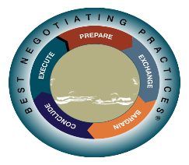
Stages of a Negotiation

Slide 49
Stages of a Negotiation
Set the goals
Identify Minimum expectations
Identify Maximum concessions
Initial points
Research
Data analysis
Implementation of the agreement
Share information &
Explore options
Strengthen the relationship and build trust for future negotiation opportunity.
4 critical assessments:
Trustworthiness
Competency
Likeability
Alignment of interests
1. Comprehensive summary of the agreement.
2. Never forget to thank the other party, even no agreement
Make your concessions
Manage opposite’s concessions
Reach agreements
Look for authority of the representative
Negotiator’s tools
Behavioral tools
Communication skill

Slide 50
.
FIVE STAGES OF A NEGOTIATION
STAGES | CONCERNS OF THE STAGES
 | Value of the dispute | Interests of the parties | Relationship between the parties
Stage 1: Prepare | Identify potential value (And also being aware of conflict, the history leading to the negotiation, the people involved and others) | Begin to understand interests | Consider the relationship you want to build.
Stage 2: Information Exchange and Validation | Discovering and creating value. | Explore options that address interests and Assess interests. | Build relationship and trust
Stage 3: Bargain ("give-and-take" stage) | Continue to create value and distribute value | Address interests | Make and manage concessions (discounts). (Negotiators’ finely tuned communication skills and behavioral skills, by excluding wrong emotions, matter greatly here.)
Stage 4: Conclude (Agreement Stage) | Capture value | Confirm interests have been met. (This is the time to put down in writing the common interests and time for agreement.) | Thank them– even when no agreement is reached.
Stage 5: Execute | Expand value | Addressing changing interests | Strengthen relationships

Slide 51
Stages of negotiation are expressed separately:

Slide 52
.
STAGE-1 FROM FIVE STAGES OF A NEGOTIATION
STAGES | CONCERNS OF THE STAGES
 | Value of the dispute | Interests of the parties | Relationship between the parties
Stage-1: Prepare | Identify potential value (And also being aware of conflict, the history leading to the negotiation, the people involved and others) | Begin to understand interests | Consider the relationship you want to build.

Slide 53
.
STAGE-1 FROM FIVE STAGES OF A NEGOTIATION
STAGES | CONCERNS OF THE STAGES
 | Value of the dispute | Interests of the parties | Relationship between the parties
Stage 2: Information Exchange and Validation | Discovering and creating value. | Explore options that address interests and Assess interests. | Build relationship and trust

Slide 54
.
STAGE-1 FROM FIVE STAGES OF A NEGOTIATION
STAGES | CONCERNS OF THE STAGES
 | Value of the dispute | Interests of the parties | Relationship between the parties
Stage-3: Bargain (‘give-and- take’) stage. | Continue to create value and distribute value | Address interests | Make and manage concessions (discounts) (Negotiators’ finely tuned communication skills and behavioral skills, by excluding wrong emotions, matter greatly here.)

Slide 55
.
STAGE-1 FROM FIVE STAGES OF A NEGOTIATION
STAGES | CONCERNS OF THE STAGES
 | Value of the dispute | Interests of the parties | Relationship between the parties
Stage 4: Conclude (Agreement Stage) | Capture value | Confirm interests have been met. This is the time to put down in writing the common interests and time for agreement. | Thank them– even when no agreement is reached.

Slide 56
.
STAGE-1 FROM FIVE STAGES OF A NEGOTIATION
STAGES | CONCERNS OF THE STAGES
 | Value of the dispute | Interests of the parties | Relationship between the parties
Stage-5: Execute | Expand value | Addressing changing interests | Strengthen relationships

Slide 57
SUMMARY TO: FIVE STAGES OF A NEGOTIATION
Stages of a Negotiation
Stage 1:
Prepare
Stage-3:
Bargain stage.
Stage 2:
Information Exchange and Validation
Stage 4:
Conclude Stage
Stage-5:
Execute

Slide 58
NEGOTIATION SKILL DEVELOPMENT

Slide 59
Strengthening creative ability for resolving a dispute.
Keep track of your points at all times.
Learn to know and understand your position.
Learn about things of dispute, even if it is outside your specialty.
Avoid rigid, set patterns of doing things.
Be alert in your observations.
Keep your sense of humor. You are more creative when you are relaxed.

Slide 60

Developing effective communication skill
Learn to Listen
Empathize
Encourage
Treat People Equally
Have a Script for Small Talk and Other Occasions
Maintain a Positive Attitude and Smile (Watch Your Body Language)
Minimise Stress
Put Away the Distractions
Be Brief Yet Specific
Only Complain when Absolutely Necessary

Slide 61
Understanding and Identifying bargaining styles
StyleNo-1: The Competitor: They are perceived as the most aggressive style.
StyleNo-2: The Problem Solver: This type of negotiator has the ultimate goal of a mutually beneficial result that meets needs of parties on both sides of the negotiation.
StyleNo-3: The Compromiser: Much like the Problem Solver, the Compromiser also sees their efforts as being a means to satisfy both sides of a negotiation. However, their main goal is to foster a trusting business relationship that will move their party forward in the long run.

Slide 62
Understanding and Identifying bargaining styles
StyleNo-4: The Accommodator: The style of the Accommodator commonly takes the approach of a negotiation with the desire to achieve a long-term goal of securing mutual gain from the outcome. An Accommodator accomplishes this goal by implementing a legitimate aspiration to advance the needs of the other party.
StyleNo-5: The Conflict Avoider: They are the final style of the bargaining personalities. This bargaining position can be frustrating because it ignores the primary aspect of conflicts that typically arise in a negotiation. By avoiding specific conflicts during a negotiation, the Conflict Avoider tends to add to the unpleasantness that can arise out of these situations. The result of this style is that the Conflict Avoider may create frustration related to the important topics of the negotiation, ultimately resulting in a losing situation on their end.

Slide 63
Understanding and Identifying bargaining styles
Realize that no matter which negotiation style becomes your preference, there is no guarantee that you will match the bargaining ideals of your negotiating counterpart. The key to the success of any style that you choose to incorporate in a negotiation is to prepare your approach to an opposing situation in advance. This will allow you to produce a strategy that will encourage a persuasive argument that solidifies your expectations of the negotiation to your counterpart. As in most business situations, knowledge of every angle is the path to success. Failure to understand every aspect of the negotiation terms and your opponent’s style, end goal, can ultimately place you on the vast landscape of the losing position of the transaction after all has been finalized.

Slide 64
Learning to stay more in control
Always focus On Solutions:
Don’t Seek Perfection:
Avoid Asking “What If?”:
Squeeze Negative Self-Talk:

Slide 65
Building and maintaining more successful relationships through Negotiation
Be Authentic
Identify Shared Goals and Values
Develop Mutual Respect
Share your Vulnerability (if any)
Show loyalty to other.
Get More Personal
Plan Something Fun to Do Together:
Accept the way people are, not as you want them to be.

Slide 66
Techniques for concluding a negotiation successfully/closing the deal
1. Diagnose the Barrier: When you’ve made progress on certain issues but remain obstructed on others in a negotiation, it’s time to take a hard look at what’s standing between you and a mutually acceptable deal. Sometimes a tag-team approach is needed to reach closure. The first cohort of negotiators may settle some important issues but run out when it comes to others. A fresh team may bring a new perspective without the burden of personality problems developed by their predecessors. Changing the lineup may be especially useful if early negotiators have limited authority.

Slide 67
Techniques for concluding a negotiation successfully/closing the deal
2. Use the Clock
Negotiations expand to fill the time available. We may not like to make important decisions under the gun, but deadlines can provide a healthy incentive to closing the deal. You recognize your priorities, and keep channels of communication open, you’ll be able to move quickly and wisely when you have to.

Slide 68

Techniques for concluding a negotiation successfully/closing the deal
3. Sign Here
Most important deals require a written contract. Whatever you’ve gained through artful negotiation will go down the drain if the understanding you reached is poorly reflected in formal documents.

Slide 69

Techniques for concluding a negotiation successfully/closing the deal
A successful closing the deal can be called as-“building a golden bridge.” It involves allowing the other side to make a graceful exit – and practicing the diplomatic art of letting others have your way.

Slide 70
HOW TO GET TO ‘YES’ : A PRACTICAL APPROACH

Slide 71
How to get to ‘yes’: From Conflict to Cooperation
By improving communication styles:
By improving communication styles, focusing especially on non-verbals and listening. Listening to others can solve thousands of problems. You should practice listening skills and become far more aware of both verbal and non-verbal messages. You should listen and should understand what people are really saying.

Slide 72
How to get to ‘yes’: From Conflict to Cooperation
By recognizing negotiation styles of your own and of others:
Capacity to read oppositions mind is one of the key factor to win a fight. Changing the style of ownself in line of the style of the opposition.

Slide 73
How to get to ‘yes’: From Conflict to Cooperation
By understand the behavior:
By understand the behavior of individuals, groups and organizations in the context of competitive situations. You need to read the circumstances of the opposition, need to have an extensive research on the fact of the dispute.

Slide 74
How to get to ‘yes’: From Conflict to Cooperation
By developing and practicing win/win solutions skill:
By developing and practicing negotiation skills leading to win/win solutions. Find out the point of ‘no loss’ for you and, if possible, for the opposition. Make a plan starting from this point of ‘no loss’ and go upto the position where both the parties will be in the winning position.

Slide 75
How to get to ‘yes’: From Conflict to Cooperation
By learning powerful influencing strategies and bargaining tactics:
By these strategies you will reach to the situation where both the parties will be the winner. The steering should be in your hand but making no harm to the relation and giving no chance to the opposition to understand that you are leading the negotiation.

Slide 76
How to get to ‘yes’: From Conflict to Cooperation
By integrating resistance point, target and bargaining zone:
On the strategy, to reach the destination, you should integrate fighting point, target and bargaining zone into all negotiation plans.

Slide 77
How to get to ‘yes’: From Conflict to Cooperation
By maximizing own position:
Learning how to maximize own position through building alliances, controlling environment, and doing “homework”.

Slide 78
How to get to ‘yes’: From Conflict to Cooperation
Say ‘yes’ and make the other to say the same:
Overall, making yourself to say ‘yes’ as well as making opposition to say ‘yes’.

Slide 79
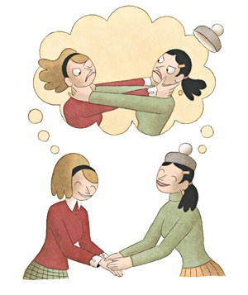
How to deal with a difficult people:

Slide 80
How to deal with difficult people?
Difficult people may be as confrontational, demanding, hostile, or even abusive.
With smart approach and intelligent communication, you may turn aggression into cooperation, and arrogance into respect.
Just a few tips are in next few slides on how to negotiate with difficult individuals:

Slide 81
How to deal with difficult people?
Tip-1: Meet in Private if Possible:
When it's safe and possible to do so, negotiate with difficult people in private where they may be more flexible. In most (but not all) cases, avoid disagreements with them in front of others, where they’re more likely to be inflexible. The exception is if the difficult individual is hostile and/or abusive, then strong intervention with witnesses may be needed.

Slide 82
How to deal with difficult people?
Tip-2: Neutralize Their Home Court Advantage:
Whenever possible, meet with difficult individuals at a neutral location (i.e. conference room instead of their office, coffee shop instead of their home), to help reduce their sense of home court dominance.

Slide 83
How to deal with difficult people?
Tip-3: Be Assertive and Professional in Communication:
Many difficult people respect those with strength, and listen more to those who communicate with assertiveness.

Slide 84
How to deal with difficult people?
Tip- 4: Bring Solutions:
Let the difficult person know that you yourself are in control. If there is an issue, don’t go to the difficult person just to discuss the problem. Go with solutions in mind. Many difficult individuals work most positively with those who present themselves from a position of strength. They’re more willing to communicate and work with those who take the initiative, and lend their cooperation to those who show they can help themselves.

Slide 85
How to deal with difficult people?
Tip-5: Focus on Consequence:
The ability to identify and assert consequence(s) is one of the most important skills you can use to "stand down" a difficult person. Effectively articulated, consequence gives pause to the challenging individual, and compels him or her to shift from obstruction to cooperation.

Slide 86
How to deal with a Difficult Customer:
You should understand the demeanor of the customer, some are-
NO | EMOTION | EXPRESSION
1. | Sadness | Angling upward of the inner corners of the eyebrow. Vertical wrinkle between the brows will appear, when the eyebrows are drawn up and together. Lips stretched horizontally, pushed up. Skin between the tip of the chin and lower lip may be wrinkled and pushed upward, by the action of chin muscle.

Slide 87
How to deal with a Difficult Customer:
You should understand the demeanor of the customer, some are-
NO | EMOTION | EXPRESSION
2. | Anger | Lower and upper eyelids become tightened. Eyebrows drawn together. Jaw is often thrust forward. Lips are pressed. Lower lip pushed up.

Slide 88
How to deal with a Difficult Customer:
You should understand the demeanor of the customer, some are-
NO | EMOTION | EXPRESSION
3. | Surprise | The brows are raised and curved. Skin below the brow is stretched. Horizontal wrinkles across the forehead. Eyelids are opened, white of the eye showing above and below. Jaw drops open and teeth are parted but there is no tension or stretching of the mouth. Surprise, compared to other emotions, lasts only few seconds. Surprise passes when we figure out what is happening , then it transfers into fear, anger, disgust, relief etc, depending on what has surprised us.

Slide 89
How to deal with a Difficult Customer:
You should understand the demeanor of the customer, some are-
NO | EMOTION | EXPRESSION
4. | Fear | Brows are raised and drawn together. Wrinkles in the forehead are in the centre between the brows, not across. Upper eyelid is raised, but the lower lid is tense and drawn up. Upper eye has white showing, but not the lower white. Mouth is open and lips are slightly tensed or stretched or drawn back.

Slide 90
How to deal with a Difficult Customer:
You should understand the demeanor of the customer, some are-
NO | EMOTION | EXPRESSION
4. | Fear | Brows are raised and drawn together. Wrinkles in the forehead are in the centre between the brows, not across. Upper eyelid is raised, but the lower lid is tense and drawn up. Upper eye has white showing, but not the lower white. Mouth is open and lips are slightly tensed or stretched or drawn back.

Slide 91
How to deal with a Difficult Customer:
You should understand the demeanor of the customer, some are-
NO | EMOTION | EXPRESSION
5. | Happiness | Corners of the lips are drawn back and up. Mouth may or may not be parted, teeth exposed. A wrinkle runs from outer nose to outer lip. Cheeks are raised. Lower lip may show wrinkles or be tense. Crows feet near the outside of the eyes.

Slide 92
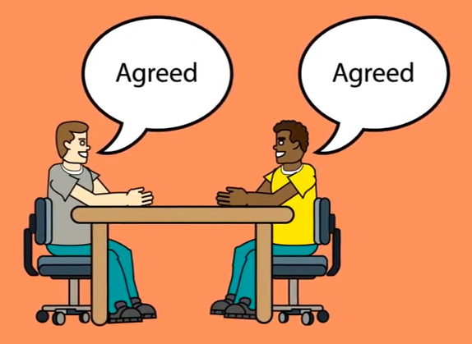
A special analysis:
Characteristics of integrative negotiation
(The Harvard method):

Slide 93
Characteristics of integrative negotiation (The Harvard method):
Founders of the Method:
This method was developed at Harvard University by Professors Roger
Fisher and William Ury in the book “Getting to Yes” in 1980’s.

Slide 94
Characteristics of integrative negotiation (The Harvard method):
What is Integrative Negotiation?:
It has been a question for several years: what style of negotiation is most effective: cooperation or competition? In reality, research and practice have demonstrated that neither of these two styles has a domination on effectiveness. Effectiveness in negotiation does not depend on the style adopted, but rather on the strategy deployed. Real effectiveness in negotiation comes from having the flexibility to adjust and adapt oneself permanently to the context and the panelist.

Slide 95
Characteristics of integrative negotiation (The Harvard method):
Integrative Negotiation based on:
This negotiation strategy is based on focusing on the interests of the parties involved and not on the positions that the negotiators may initially take. Given that the purpose of integrative negotiation is to find a common and satisfactory agreement, sometimes we find that the concept of “win-win negotiation” is synonymous with this strategy.
Employee’s position: She has asked to be assigned to Project. Employee’s interest: to get promoted, she needs to succeed on a project of high visibility.

Slide 96
How to deal with a Difficult Customer:
You should understand the demeanor of the customer, some are-
NO | EMOTION | EXPRESSION
1. | Sadness | Angling upward of the inner corners of the eyebrow. Vertical wrinkle between the brows will appear, when the eyebrows are drawn up and together. Lips stretched horizontally, pushed up. Skin between the tip of the chin and lower lip may be wrinkled and pushed upward, by the action of chin muscle.

Slide 97
Characteristics of integrative negotiation (The Harvard method):
Pillars of integrative negotiation
If we present this strategy more concretely, we can determine that this strategy is founded on these four pillars:
Pillar-1: Separate the people from the problem subject to negotiation: Topics should be based more on the merits that the individuals involved possess rather than on their emotions.

Slide 98
Characteristics of integrative negotiation (The Harvard method):
Pillars of integrative negotiation
If we present this strategy more concretely, we can determine that this strategy is founded on these four pillars:
Pillar-2: Focus on the interests of the parties involved, not on the positions: The interests that are brought to a negotiation among different parties are, in the end, quite similar. Focusing on the interests, the parties may find that they are not as opposed to each other as they might think at first. Every discussion about interests should propose concrete and specific details. This allows the interests to be conceived as more real and credible.

Slide 99
Characteristics of integrative negotiation (The Harvard method):
Pillars of integrative negotiation
If we present this strategy more concretely, we can determine that this strategy is founded on these four pillars:
Pillar-3: Generate different options for mutual gain: Sometimes, people can be too strict when coming up ideas. For example, they may negatively judge the ideas proposed in the brainstorming phase when really, we should allow creativity to flow during the proposal phase and evaluate these ideas a posteriori.

Slide 100
Characteristics of integrative negotiation (The Harvard method):
Pillars of integrative negotiation
If we present this strategy more concretely, we can determine that this strategy is founded on these four pillars:
Pillar-4: Base the agreement reached on objective criteria: For example, if two parties are involved in the buying and selling of a house, objective criteria can be applied to the transaction, such as the comparable price in other sales in the zone or the analysis of an independent real estate expert.

Slide 101
BATNA (Best Alternative to a Negotiated (The Harvard method):
Roger Fisher and William Ury have also developed the concept of BATNA (Best Alternative to a Negotiated Agreement). What will you do if the dispute doesn’t settle? The stronger your BATNA, the stronger your bargaining power in a negotiation. This concept refers to the best alternative that we can possibly have when facing a negotiated agreement. It is important to note that the alternative isn’t just one option more, but rather a way to satisfy our interests in the event that we cannot do so in the field of negotiation.
Today, this is the negotiation strategy most respected and utilized by experts, academics, and professionals in the world of negotiation.

Slide 102

Conclusion: Always keep in mind at the time of Negotiation:
(একজনের ভারসাম্যহীনতা নিজেকে এবং অন্যকে ভারসাম্যহীন করে তুলবে)

Slide 103
Part-4:
Group Exercise in couple on a given fact.

Slide 104
Part-5:
Individual Feedback on ‘Development towards being a good
Negotiator’.

Slide 105
THANK YOU

